Slide 1

Environmental protection in Water Tour Project
Zsolt Molnár, Marianna Radács, László Rácz, Marta Gálfi
Institute of Applied Natural Science, Juhász Gyula Faculty of Education, University of Szeged, Hungary

Slide 2
Aims in HUSRB/1602/31/0204 WATERTOUR PROJECT
Our aims are all trought the HUSRB/1602/31/0204 WATERTOUR PROJECT realisation, the reduction of the environmental risks.
These aims are realized by the University of Szeged, Juhász Gyula Faculty of Education, Institute of Applied Natural Science, Department of Environmental Biology and Environmantal Education:
→ the direction of EU – 2020 strategy was used.

Slide 3
In the WATERTOUR PROJECT the next priority fields were defined:
- decreased the risks of climate-change,
- saving of biodiversity,
- recognition and protection the values of natural and environmental objectives.

Slide 4
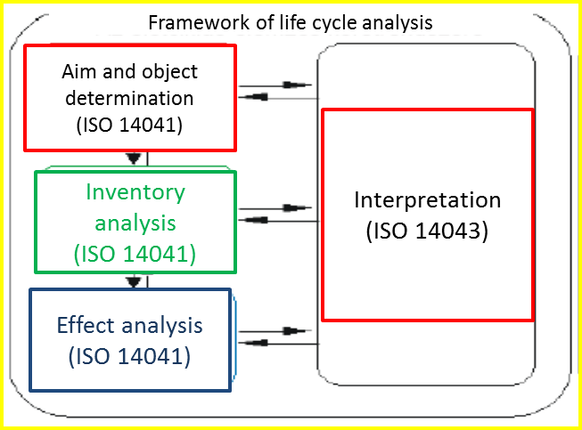
We want to build system compatibility with the next EU declarations and international standards:
- 1303/2013 és 2014/52/EU and
- 14040 ISO Standard (Life cycle analysis)

Slide 5
Question between the environment, society and the economy
Balance: between the environment, society and the economy is essential to meet the needs of the present, without compromising the ability of future generations to meet their needs
Sustainable development is the goal → by balancing the three pillars of sustainability

Slide 6
Environmental management by International Standard of 14001:2015
Aims:
  - Protecting the environment by preventing or mitigating adverse environmental impacts
  - Enhancing environmental performance
  - Using life cycle perspective
  - Communicating environmental information to relevant interested parties

Slide 7
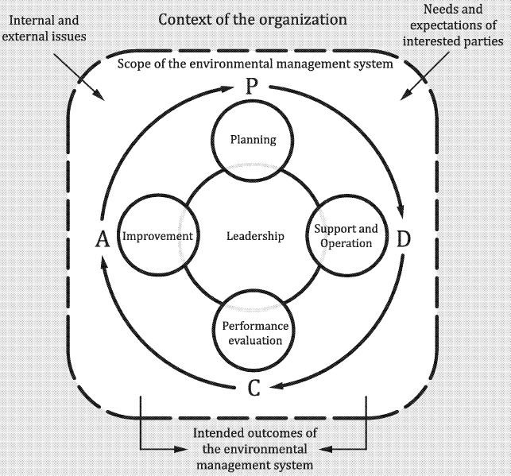
To reach the aims PDCA cycle is needed
Plan: establish environmental objectives and processes (related to this project)
Do: implement the processes as planned (safe of the climate and biodiversity)
Check: monitor and measure processes (environmental risks controlling)
Act: take actions to continually improve

Slide 8
Importance of PDCA cycle
- Climate protection - with prudent and inverse logistics and the removal of organic waste,
- Preserving biodiversity - minimizing disruption during hikes,
- Protection of nature and environmental values - by creating a conscious protection of those listed in the depository.

Slide 9
We can see the role of water as an environmental element in connection with the hiking trails, linked to wetlands; and its relationship with the importance of today's society,
- All in all, focusing on environment-centred public procurement is deliberately minimizing environmental risks.

Slide 10
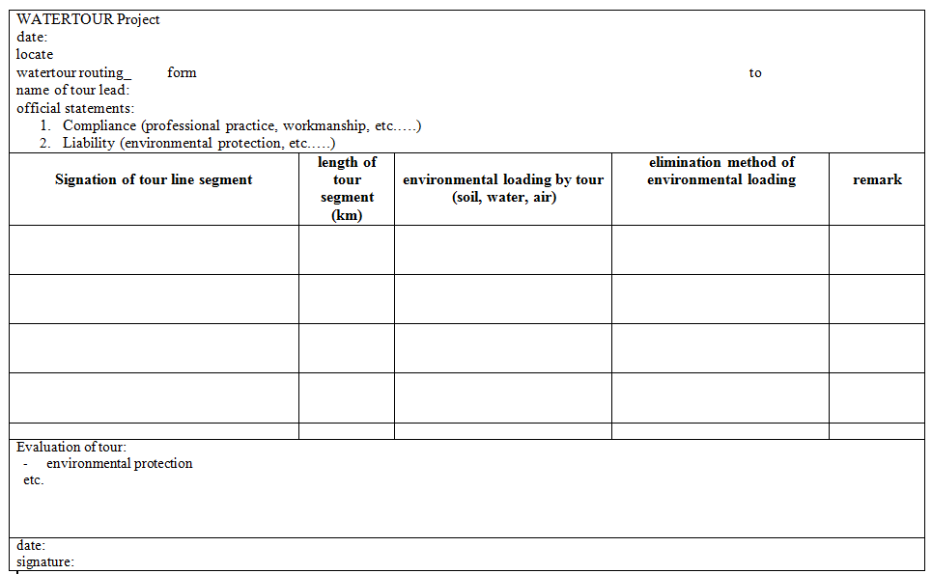
Checklist during WATERTOUR PROJECT
Highlight of the project:
Security of:
- health,
- environment-nature,
- value consciousness

Slide 11
Enforcing environmental security in procurement is a task that requires direct environmental focus in all project and public sector activities.
With public procurement, we can build regulatory elements on the principle of binding to implementation modes that can make investment and / or project elements almost life-cycle analysis centred.
- While these solutions may seem compelling at first in the case of new purchases, they also support an environmentally friendly design that is a requirement of EU directives.

Slide 12
References
Gray, R.H. - J. Bebbington - D. Walters: Accounting for the Environment (The Greening of Accountancy, Part II), Paul Chapman Publishing Ltd., London, 1993.,
2015 CXLIII. Act on Public Procurement,
Public Procurement Review 2016. VI. Grade 9 - Public Procurement Studies, Articles: Towards Strategic Directions - Change in Approach to New Public Procurement Directives,
Public Procurement Review 2017. VII. Grade 3 - Public Procurement Studies, Articles: Sustainability Aspects in Public Procurement,
Public Procurement Review 2017. VII. Year 12 Public procurement studies, articles: The issue of sustainability in Hungarian public procurement law, with special regard to the practice of state-owned business associations,
www.kozbeszerzes.hu,
www.lca.hu.

Slide 13
Thank you for your attention!
Disclaimer:
This document has been produced with the financial assistance of the European Union. The content of the document is the sole responsibility of University of Szeged and can under no circumstances be regarded as reflecting the position of the European Union and/or the Managing Authority.

